Slide 1
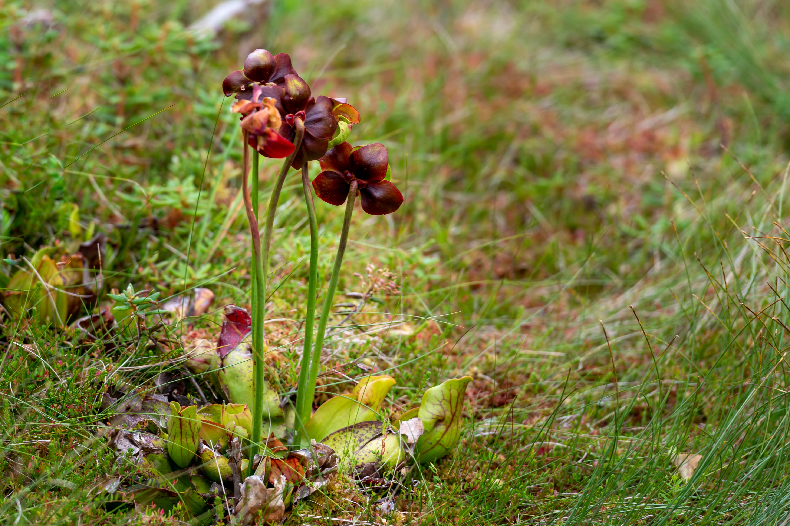
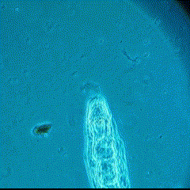

The search for indirect ecological effects of evolution in pitcher plant rotifers
Alex Mendelson
Alex A. Mendelson*, Casey P. terHorst
California State University, Northridge

Slide 2

Evolution-mediated indirect effects on ecology
Species A
Species B
Higher Temp
Interaction
evolution
Climate Change
Indirect effect
Notes:
Have A change color when you say “A evolved”
Scratch prev slide
Change title (eco evo effects)

Slide 3
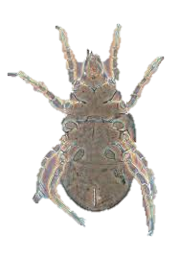
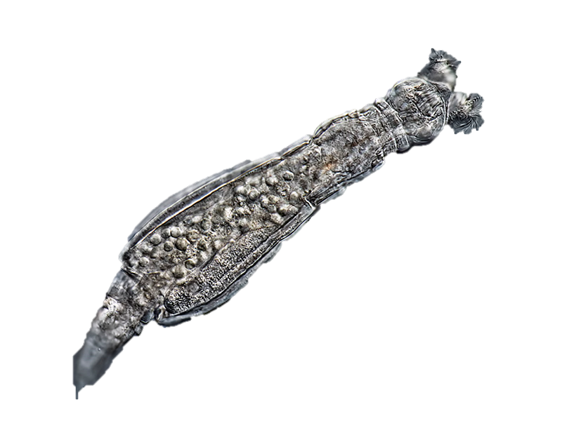
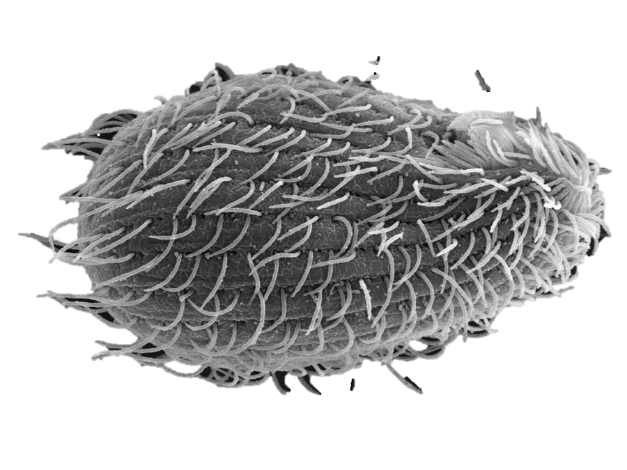

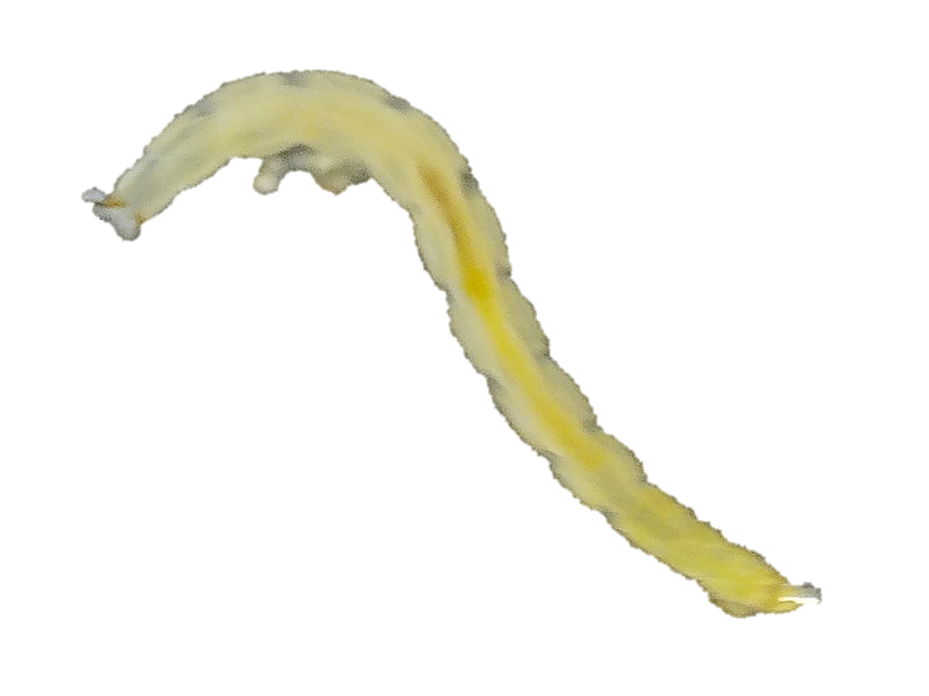
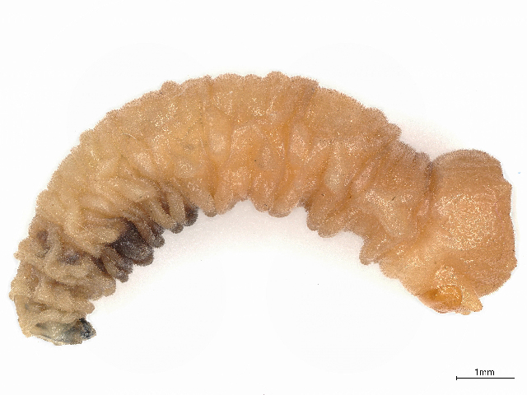
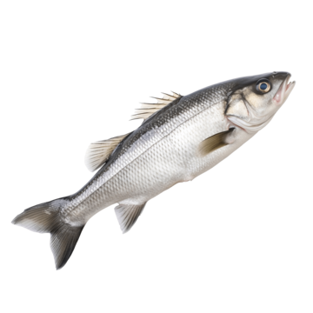
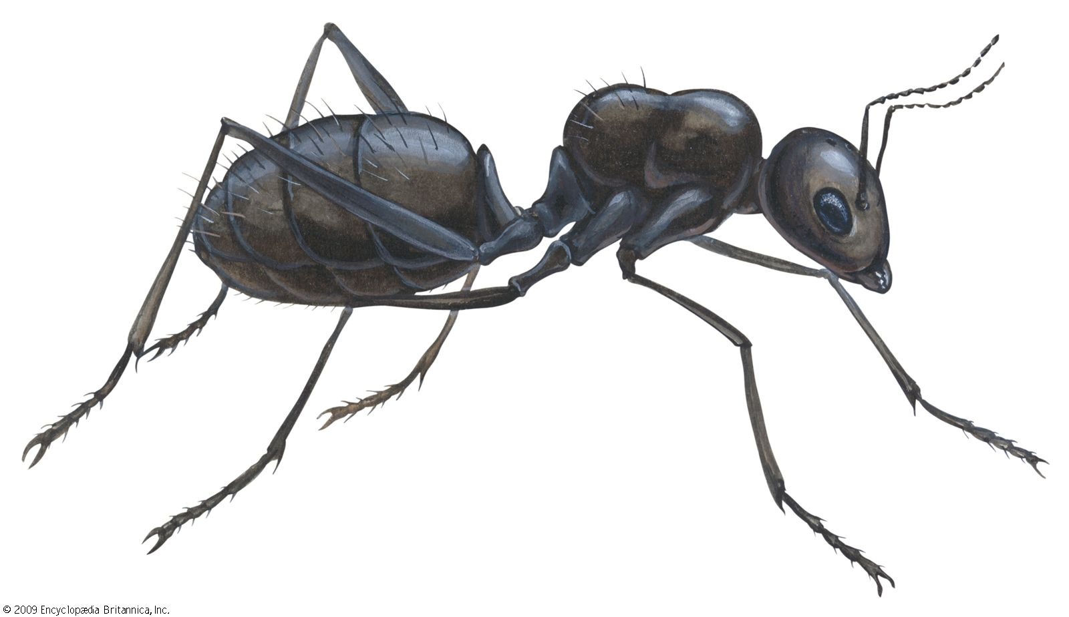
Pitcher plant leaf water community
Bacterivores
Omnivores
Rotifers
Protists
Mites
Bacteria
Sarracenia purpurea
Detritivores
Purple pitcher plant
Prey
Midge & Fly Larvae
Notes:
Don’t forget the fish
Reverse arrows
Check what mites eat

Slide 4
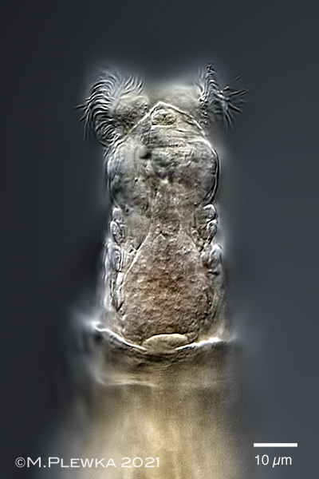
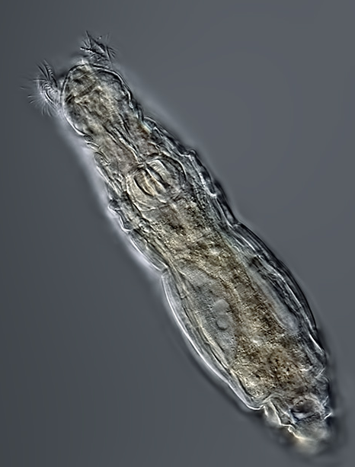
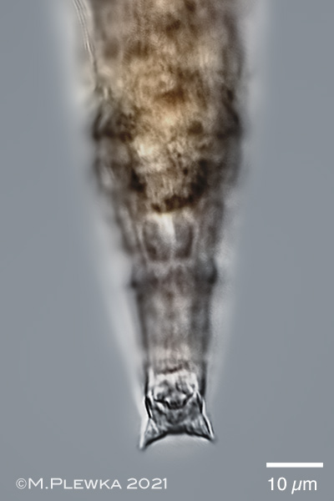
Habrotrocha rosa
Bacterivores
Rotifers
Protists
Michael Plewka
Microbes
Prey
25 µm
Michael Plewka
Michael Plewka

Slide 5
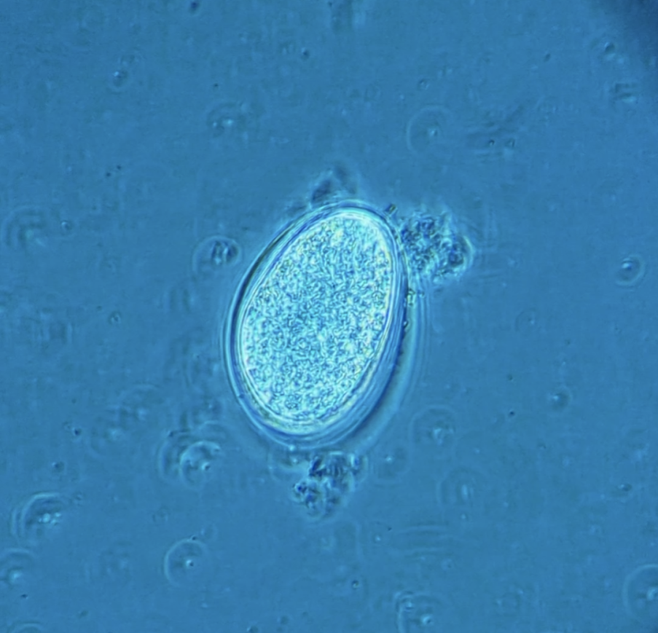
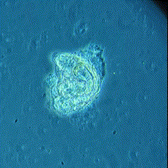
Habrotrocha rosa
Obligately parthenogenetic (apomixis) Offspring are clonal
Generation time 1–2 days
Egg (~6 hours)
Hatching (~12 hours)
Adult (~24-48 hours)

Slide 6
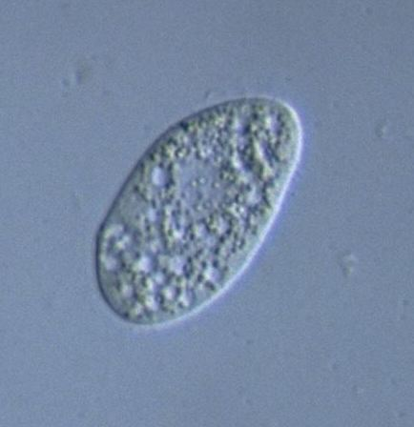
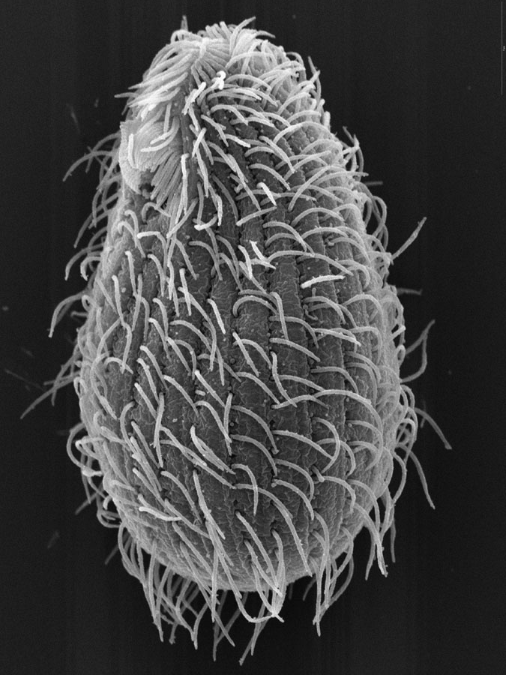
Natural competitor: Tetrahymena sp.
Bacterivores
Competition
Rotifers
Protists
Microbes
Brian Farley
Y. Tsukii

Slide 7
Do populations of H. rosa evolve in response to temperature?
2. Are populations of H. rosa affected by competition with Tetrahymena sp.?
Are there evolution-mediated effects of temperature on competition
between H. rosa and Tetrahymena sp.?
Rotifers
Protist
Higher Temp
Competition
evolution
Climate Change
Indirect effect
?₁

Slide 8
Do populations of H. rosa evolve in response to temperature?
2. Are populations of H. rosa affected by competition with Tetrahymena sp.?
Are there evolution-mediated effects of temperature on competition
between H. rosa and Tetrahymena sp.?
?₂
Rotifers
Protist
Higher Temp
Competition
evolution
Climate Change
Indirect effect

Slide 9
Do populations of H. rosa evolve in response to temperature?
2. Are populations of H. rosa affected by competition with Tetrahymena sp.?
Are there evolution-mediated indirect effects of temperature on competition between H. rosa and Tetrahymena sp.?
Rotifers
Protist
Higher Temp
Competition
evolution
Climate Change
Indirect effect
?₃

Slide 10
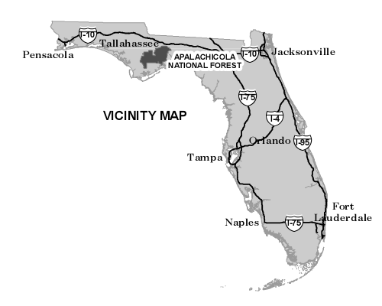
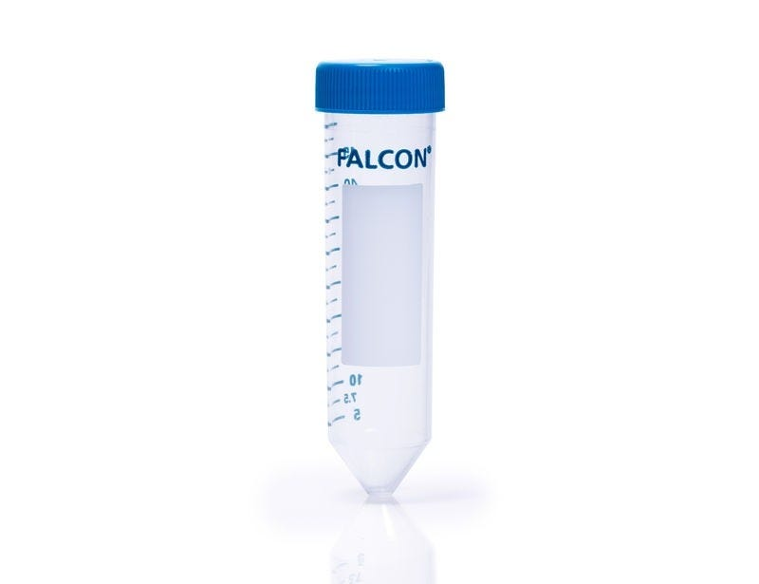
Field Sampling and Isolation
Leaf water
At each of 2 sites:
Sample 5 leaves of different plants that contain H. rosa

Slide 11
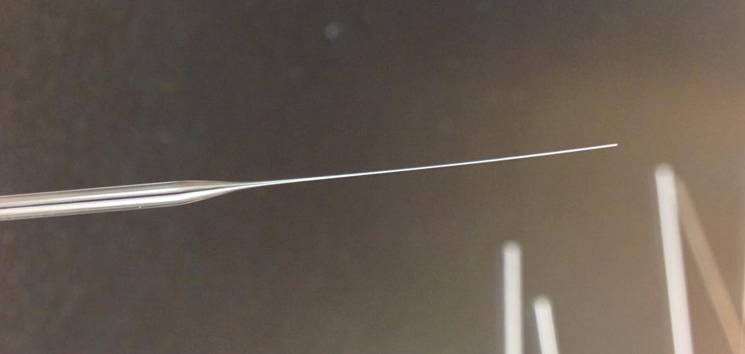
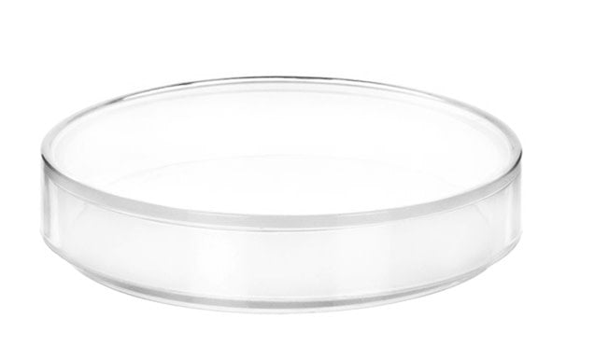
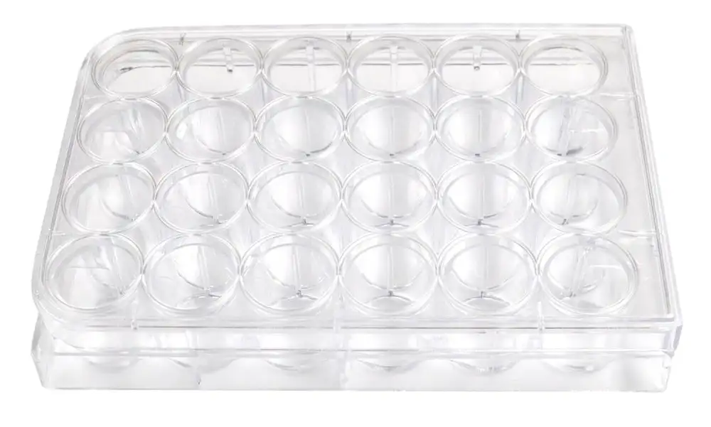
Field Sampling and Isolation
Pulled glass pipette
Leaf water
1st Isolation
2nd Isolation
3rd Isolation
24-well tissue culture plate

Slide 12
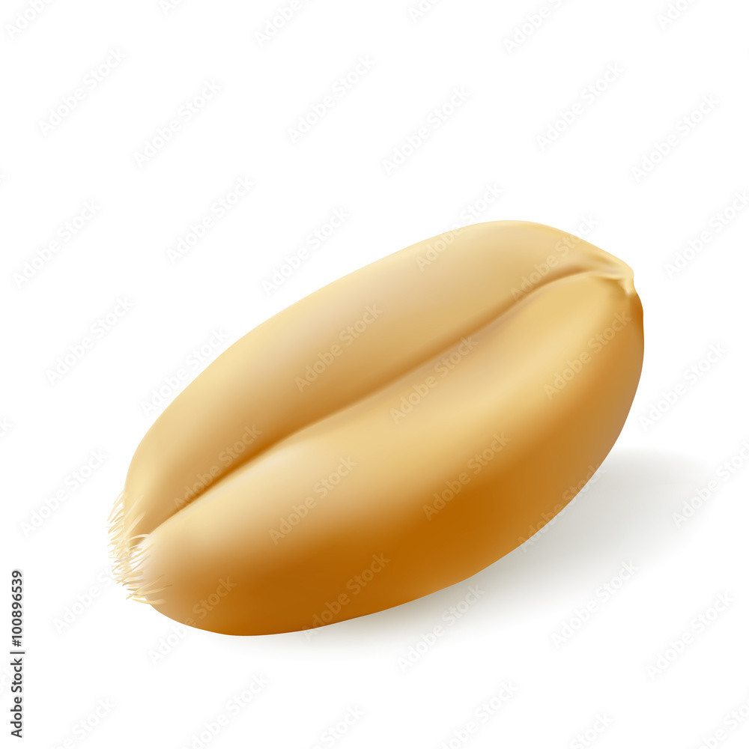
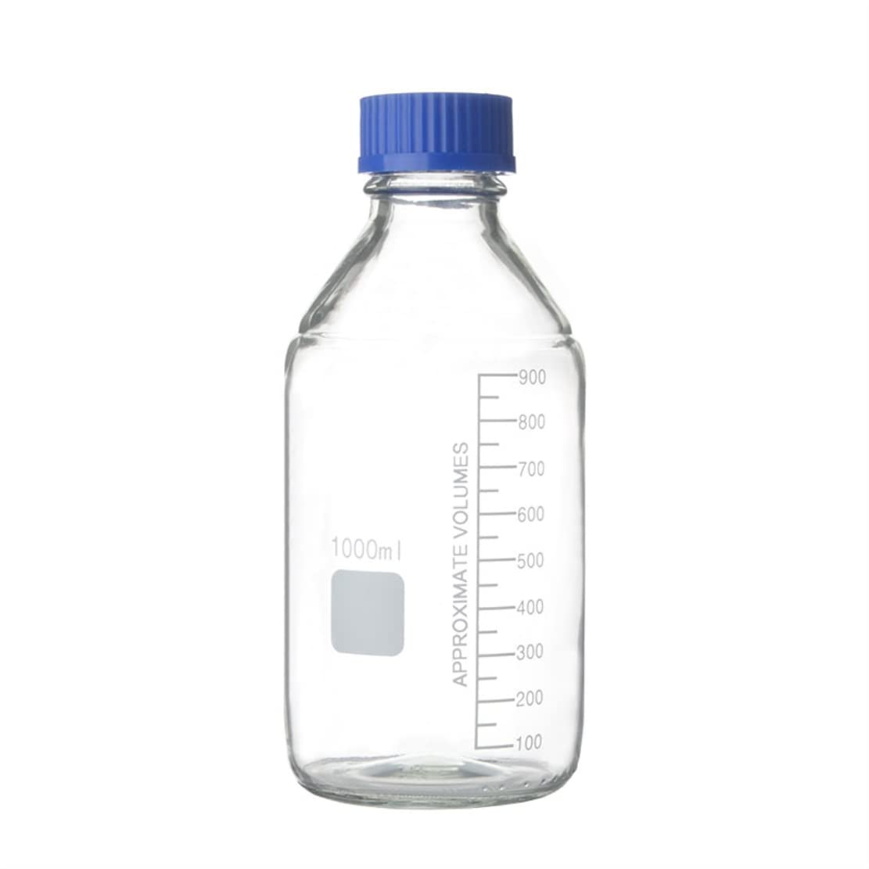
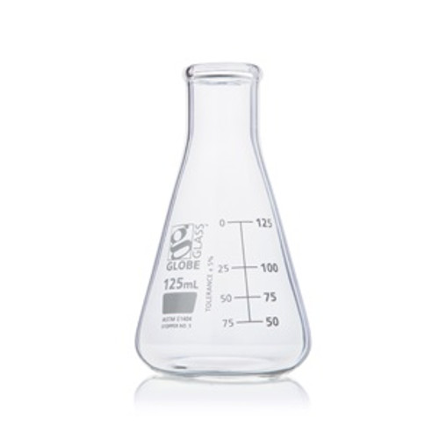
Clonal Stock Cultures
1x
Wheat seed
100 mL
Media
24-well tissue culture plate

Slide 13
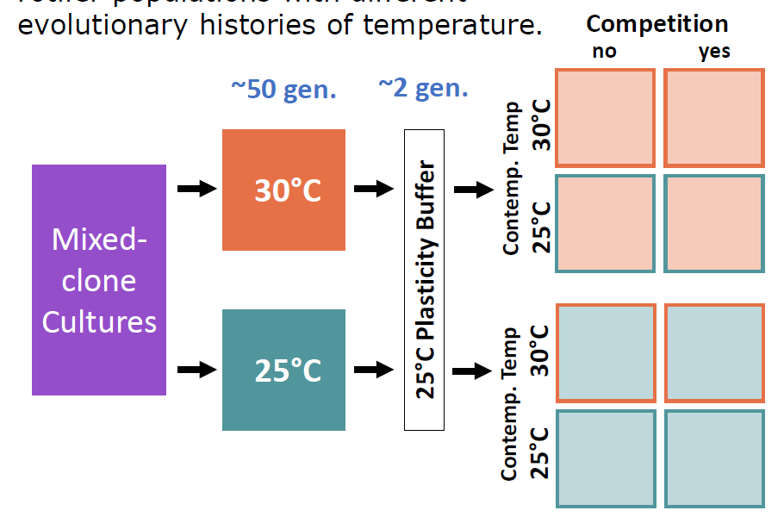
Evolution and competition experiment
n = 17 clones mixed to mimic natural diversity
Mixed cultures fed 200 μL of crushed fish food solution once very 6 days
250 mg sterile, finely ground Tetra Color Tropical Flakes dissolved in 15 ml deionized water
50 generation (120 d) evolution period in temperature-controlled growth chambers
50% ‘water change’ every 40 d

Slide 14
Evolution and competition experiment
2 generation plasticity buffer after evolution period
80 new cultures established for full crosses of evolved T, contemporary T, and competition
n = 10 for each three-factor cross
Tetrahymena sp. also grown alone at 25 °C and 30 °C
Protists only
25 °C
30 °C

Slide 15
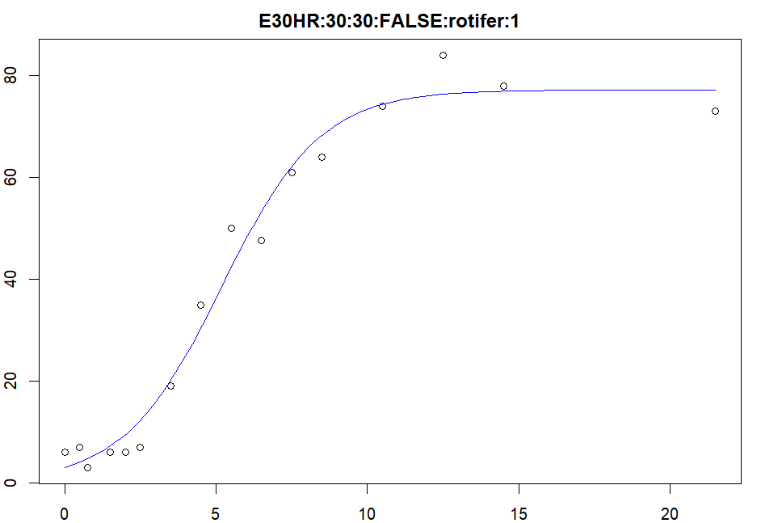
Trait measurement
Growth parameters
Rotifer and protist abundance measured over 21 d
Sampling interval increased over time
Total of 16 timepoints
Logistic growth model
growthrates package (v.0.8.4) in R (v.4.5.1)
Maximum growth rate (r)
Carrying capacity (K)
r = 0.6154
K = 77.1889
Every 6 h
Every 12 h
Every 1 d
Every 2 d
Every 8 d
0d
1d
1.5d
2d
2.5d
3d
4d
7d
9d
13d
21d
d22
6h
18h
Notes:
Fewer sig figs on r and K
Try full line without breaks, strike day labels, with all 16 timepoints

Slide 16
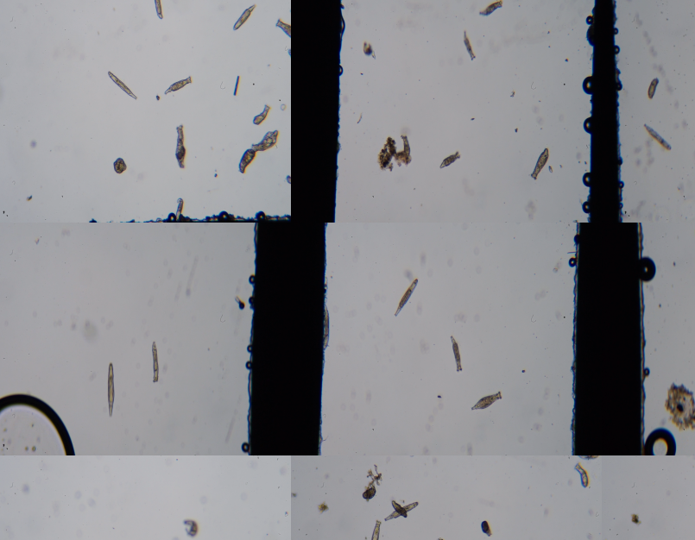
Trait measurement
Size
Rotifers imaged at the beginning of the experiment
n > 200 for each evolutionary history
Data to be analyzed!
Size measured
Every 6 h
Every 12 h
Every 1 d
Every 2 d
Every 8 d
0d
1d
1.5d
2d
2.5d
3d
4d
7d
9d
13d
21d
d22
6h
18h

Slide 17
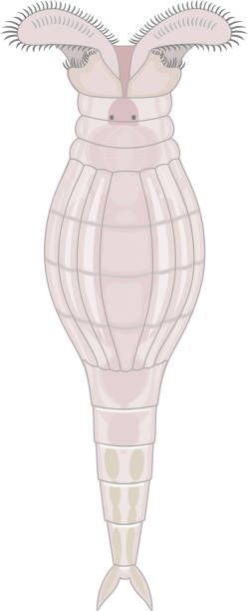
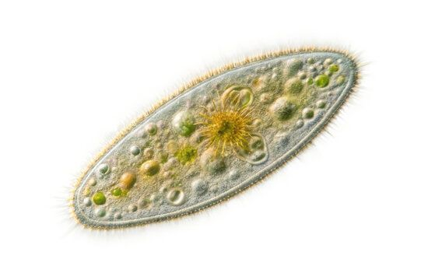
Analyses
Rotifer growth rate (r) and carrying capacity (K)
3-way ANOVA (Type III)
Fixed factors:
evolved temperature (30 °C, 25 °C)
contemporary temperature (30 °C, 25 °C)
competition (true, false)
Protist growth rate (r) and carrying capacity (K)
2-way ANOVA (Type III)
Fixed factors:
contemporary temperature (30 °C, 25 °C)
competition
no competition
rotifers evolved @ 25 °C
rotifers evolved @ 30 °C
Transformations
All growth rate data were ln-transformed to meet test assumptions
Post-hoc comparisons
p-values adjusted using Tukey’s HSD
Notes:
No (Type III)

Slide 18
Do populations of H. rosa evolve in response to temperature?
Rotifers
Protist
Higher Temp
Competition
evolution
Climate Change
Indirect effect
?₁

Slide 19
Rotifers that evolved at 25 °C had a higher carrying capacity
Carrying capacity of H. rosa
F_{1,72} = 12.1784, p = <0.001
Independent of current temperature and competition
K was 13 % higher for cultures that evolved at 25 °C compared to 30 °C (estimate = 6.88 ± 2.66 SE, t₇₂ = 3.490, p = <0.001)
n = 40
no effect of evolved temperature on growth rate (p = 0.67)
Notes:
No F values in talks (if left, 3 sig figs)
P-val on the plot
No estimate needed

Slide 20
Rotifers that evolved at 25 °C had a higher carrying capacity
F_{1,72} = 12.1784, p = <0.001
Independent of current temperature and competition
K was 13 % higher for cultures that evolved at 25 °C compared to 30 °C (estimate = 6.88 ± 2.66 SE, t₇₂ = 3.490, p = <0.001)
no effect of evolved temperature on growth rate (p = 0.67)
n = 40
Notes:
This instead of bar graph

Slide 21
2. Are populations of H. rosa affected by competition with Tetrahymena sp.?
Are there evolution-mediated indirect effects of temperature on competition between H. rosa and Tetrahymena sp.?
?₂
Rotifers
Protist
Higher Temp
Competition
evolution
Climate Change
Indirect effect
?₃

Slide 22
Rotifers experiencing competition had a lower carrying capacity
Carrying capacity of H. rosa
F_{1,72} = 83.8615, p = <0.001
Independent of current temperature and evolution
K was 27 % lower for cultures experiencing competition (estimate = -18.0 ± 1.97 SE, t₇₂ = -9.158, p = <0.001)
n = 40
Notes:
Reaction norms instead of bars here
Comp -> label bars “no comp” and “comp”

Slide 23
Effect of competition on rotifer r depended on current temperature
Growth rate of H. rosa
F_{1,72} = 5.091, p = 0.0271 (comp x current temp)
At 25 °C competition had a weak effect 31% higher growth rate without competition (estimate = 0.27 ± 0.13 SE, t₇₂ = 2.08, p = 0.041)
At 30 °C competition had a strong effect 98% higher growth rate without competition (estimate = 0.682 ± 0.13 SE, t₇₂ = 5.34, p < 0.001)
Evolution had no effect on competitive response in rotifers
no competition
n = 20
competition
***
*

Slide 24
Competitive effect of rotifers on protists dependent on current temperature
Growth rate of Tetrahymena sp.
no competition
F_{1,54} = 5.354, p = 0.008 (comp x current temp)
At 25 °C competition has no effect on protist growth rate
At 30 °C protist r was 46% lower when competing with rotifers that evolved at 30 °C (estimate = 0.599 ± 0.200 SE, t₅₄ = 2.988, p = 0.0116)
Evolution had no effect on competitive effect of rotifers on protist growth rate
comp w/ 25 °C evo. rotif.
comp w/ 30 °C evo. rotif.
ns
*
ns
ns

Slide 25
Competitive effect of rotifers on protists dependent on current temperature
Carrying capacity of Tetrahymena sp.
no competition
F_{1,54} = 20.5205, p = <0.001(comp x current temp)
At 30 °C competition has no effect on protist carrying capacity
At 25 °C protist r was ~40% lower when competing with rotifers 25 °C evolved rotifers: estimate = 431.4 ± 62.7 SE, t₅₄ = 6.880, p < 0.001 30 °C evolved rotifers: estimate = 394.9 ± 62.7 SE, t₅₄ = 6.298, p < 0.001
Evolution had no effect on competitive effect of rotifers on protist growth rate
comp w/ 25 °C evo. rotif.
comp w/ 30 °C evo. rotif.
***
***
ns
ns

Slide 26
In summary…
Do populations of H. rosa evolve in response to temperature?
Yes!
Carrying capacity is higher after evolving at 25 °C
2. Are populations of H. rosa affected by competition with Tetrahymena sp.?
Yes!
…but the effect is dependent on temperature
Are there evolution-mediated effects of temperature on competition
between H. rosa and Tetrahymena sp.?
No
Competition did not differ between evolutionary histories of temperature

Slide 27
What I think is happening
Path analysis (either the real thing, or a cartoon version)

Slide 28
Future directions
Earth’s climate is becoming more variable
Rapid evolution in response to extreme temperature fluctuations

Slide 29
Eco-evo feedback
Species B
Indirect effect
Evolution
Species A
Ecology
Changes in population traits over generations
Biotic and abiotic interactions
Notes:
Explain eco-evo more
Think about it

Slide 30
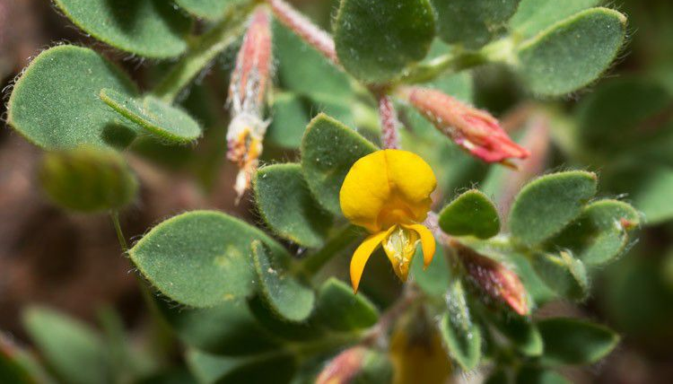
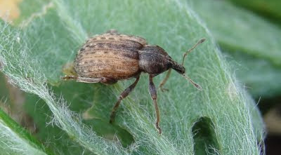
Evolution-mediated indirect effects on ecology
Herbivory
Resistance
Native Plant
Herbivore
Lau, 2012

Slide 31
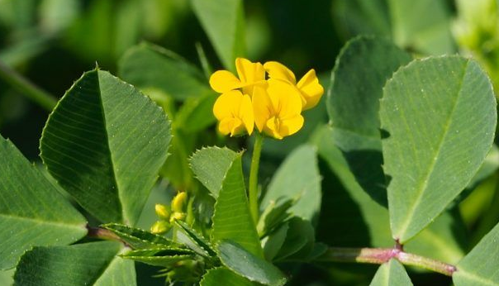
Evolution-mediated indirect effects on ecology
Herbivory
Competition
Resistance
evolution
Native Plant
Herbivore
Invasive Plant
Lau, 2012

Slide 32
Evolution-mediated indirect effects on ecology
Herbivory
Competition
Resistance
evolution
Native Plant
Herbivore
Invasive Plant
Lau, 2012

